Slide 1
Developmental Evaluation
New Mexico Evaluators
June 12, 2020
Marah Moore, MCRP

Slide 2
Polls: who’s in the “room”?

Slide 3
Developmental Evaluation: a Snapshot
Supports development of innovations and adaptation of interventions in complex, dynamic environments
Explores possibilities, generates ideas; ongoing and generative
Focuses on systems change; specific outcomes are often emergent
Evaluation methods and measures adapt as the process unfolds
Based on collaborative partnership between evaluator and those engaged in innovation process ***
Evaluator is part of the innovation team, not “external” ***
Accountability is centered on making a difference in communities

Slide 4
Developmental Evaluation
Eight Guiding Principles

Slide 5
1. Developmental Purpose Principle
Illuminate, inform, and support what is being developed, by identifying the nature and patterns of development (innovation, adaptation, systems change), and the implications of those consequences
Five purposes:
On-going development
Adapting effectiveness principles
Rapid response to crisis
Pre-formative
Major systems change

Slide 6
2. Evaluation rigor principle
Ask probing evaluation questions; think and engage evaluatively; question assumptions; apply evaluation logic; use appropriate methods; and stay empirically grounded—that is, rigorously gather, interpret, and report data
No data, no evaluation—developmental or otherwise

Slide 7
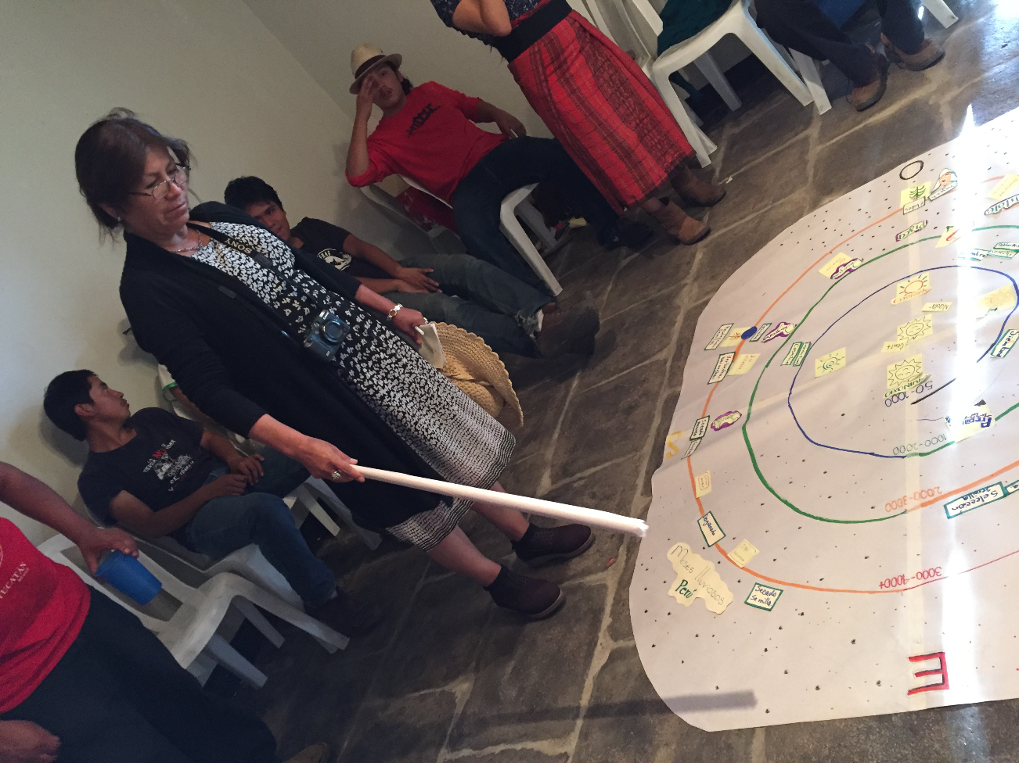
3. Utilization focus principle
Focus on intended users from beginning to end, facilitating the evaluation process to ensure utility and actual use

Slide 8
4. Innovation niche principle
Elucidate how the change process and results being evaluated involve innovation and adaptation, the niche of developmental evaluation

Slide 9
Small Group Discussion
QUESTIONS
Do you have projects that have a “developmental” purpose or that fit in the “innovation niche”?
Does the idea of rigor change when viewed through a DE lens?
Is the idea of “utilization focus” different for a DE project than one that is not developmental?

Slide 10
QUESTIONS
Do you have projects that have a “developmental” purpose or that fit in the “innovation niche”?
Does the idea of rigor change when viewed through a DE lens?
Is the idea of “utilization focus” different for a DE project than one that is not developmental?
Large Group Discussion / Q&A

Slide 11
5. Complexity perspective principle
Understand and interpret development through the lens of complexity and conduct the evaluation accordingly. This means using complexity premises and dynamics to:
make sense of the problems being addressed;
to guide innovation, adaptation, and systems change strategies;
to interpret what is being developed;
to adapt the evaluation design as needed; and
to analyze emergent findings.

Slide 12
Complex development situations are ones in which this…
Vision
IMPACT
OUTCOMES
OUTPUTS
ACTIVITIES
INPUTS
Plan
Time
Inspired by Jeff Conklin, cognexus.org

Slide 13
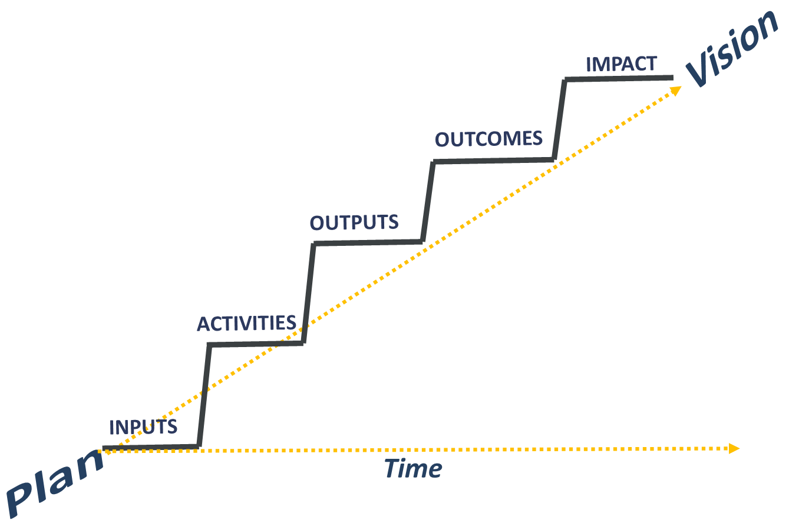
And this…
SUMMATIVE
FORMATIVE

Slide 14
Turns out to be this…
Vision and
Mission
OUTCOME
OUTPUT
OUTCOME
OUTPUT
OUTCOME
OUTCOME
ACTIVITY
OUTPUT
OUTCOME
OUTPUT
ACTIVITY
OUTCOME
INPUTS
OUTCOME
ACTIVITY
OUTPUT
INPUTS
ACTIVITY
Plan
Time
INPUTS
INPUTS

Slide 15
…and evaluation looks like this
DEVELOPMENTAL
DEVELOPMENTAL
OUTCOME
OUTPUT
Vision
OUTCOME
DEVELOPMENTAL
DEVELOPMENTAL
DEVELOPMENTAL
OUTCOME
OUTPUT
DEVELOPMENTAL
OUTCOME
DEVELOPMENTAL
ACTIVITY
OUTPUT
OUTCOME
OUTPUT
DEVELOPMENTAL
ACTIVITY
OUTCOME
INPUTS
OUTCOME
ACTIVITY
DEVELOPMENTAL
DEVELOPMENTAL
OUTPUT
INPUTS
ACTIVITY
DEVELOPMENTAL
Plan
INPUTS
INPUTS

Slide 16
6. Systems thinking principle
Think systematically throughout, being attentive to interrelationships, perspectives, boundaries, and other key aspects of the social system and context within which the innovation is being developed and the evaluation is being conducted

Slide 17
7. Co-creation principle
Develop the innovation and the evaluation together—interwoven, interdependent, iterative, and co-created—so that developmental evaluation becomes part of the change process

Slide 18
8. Timely feedback principle
Time feedback to inform ongoing adaptation as needs, findings, and insights emerge, rather than only at predetermined times (e.g. quarterly, midterm, or end of project)

Slide 19
Small Group Discussion
QUESTIONS
How do you deal with complexity and systems thinking in your projects?
Do you have examples of where your evaluation work has helped to navigate through complex systems?
Do the co-creation and feedback principles fit, or not fit, in your work?

Slide 20
QUESTIONS
How do you deal with complexity and systems thinking in your projects?
Do you have examples of where your evaluation work has helped to navigate through complex systems?
Do the co-creation and feedback principles fit, or not fit, in your work?
Large Group Discussion / Q&A

Slide 21
Poll: Barriers to Implementing DE

Slide 22
Examples of Methods that Support Developmental Evaluation
PhotoVoice
Ripple Effect Mapping
Appreciative Inquiry
Before and after-action review
Emergent learning
AND . . . Any other evaluation methods you are accustomed to using—DE is an approach, not a method

Slide 23
Large group closing discussion / Q&A

Slide 24
Thank you! Marah Moore marah@i2i-institute.com 575-758-7513

