Slide 1
Appreciative Inquiry as a Method for evaluating Programs that Build Research Capacity in Tribal Communities
Charlotte N. (Lani) Gunawardena, Ph.D
Distinguished Professor
University of New Mexico
To be Presented at the New Mexico Evaluators 2016 Conference, Albuquerque, New Mexico
Some slides previously presented at the American Evaluation Association 28th Annual Conference, October 17, 2014, Denver, Colorado
Co-Presenter : Rita Kie, MPH

Slide 2
Context: Goals of Programs that Build Research Capacity in Tribal Communities
Goal 1: Encourage research on health disparities affecting American Indian people
Goal 2: Increase the number of American Indian scientists, students, health professionals and organizations
Goal 3: Build capacity in organizations that serve tribal communities to reduce distrust by American Indian communities and people toward research
Programs included
Student development
Research projects
Advisory Board and Institutional Review Board
Administrative Oversight of the Organization

Slide 3
Appreciative Inquiry
Appreciative Inquiry “is the study and exploration of what gives life to human systems when they function at their best. This approach to personal change and organization change is based on the assumption that questions and dialogue about strengths, successes, values, hopes, and dreams are themselves transformational. Appreciative inquiry suggests that human organizing and change, at its best, is a relational process of inquiry, grounded in affirmation and appreciation.” Whitney and Trosten-Bloom (2003, p. 1)

Slide 4
Appreciative Inquiry (AI) as an Evaluation Strategy
“Appreciative Inquiry…inquires into, identifies, and further develops the best of ‘what is’ in organizations in order to create a better future” (Preskill and Catsambas, 2006, p. 1)
Emphasizes social constructivism whereby participants learn and grow together through asking questions, reflection, and dialogue
The Appreciative Inquiry model is examined as a statement of ideology/ philosophy, as an operational strategy, and as an intervention (Smith, 2010) in the evaluation of research centers that serve Native communities

Slide 5
Why Appreciative Inquiry?
Enables a client-centered approach for communication with clients
Supports consideration of the demographic, socio-cultural, socio-economic, and historical contexts within which the programs are implemented
Ability to incorporate indigenous perspectives on health education and the impact on how well a program is accepted in the communities served
Opportunity to showcase positive aspects of projects serving communities where research data is usually misrepresented
Provides a conceptual framework for planning, conducting, and communicating the evaluation in culturally responsive ways
Notes:
This project had gone through changes in PIs and evaluators, CSAC members changed, and it was important to develop trust in the evaluation process. (Usually evaluation starts when the project starts, but in this case it happened in the third year)

Slide 6
Sample Interview Questions based on Appreciative Inquiry (AI) approach
Phase 1: Inquire Appreciating the best of “what is” Were there times when you said to yourself, “this is working, this is working!” What was happening during those times? | Phase 2: Imagine What might be? If you could transform the ways in which you do your work, what would it look like, and what would it take to happen?
Phase 3: Innovate What should be the ideal? Can you think of new strategic directions for the project for the next year and beyond? | Phase 4: Implement Navigate the change What are some ways in which you can implement these strategic directions?

Slide 7
Evaluation Design & Method: Qualitative using Appreciative Inquiry Framework
In-depth individual appreciative interviews face-to-face and by phone
AI process calls for paired or group interviews so participants can hear each others’ stories
Inquire Phase: Participants engage in paired interviews
Imagine, Innovate, Implement Phases: Group interviews
Open-ended appreciative survey questions

Slide 8
Appreciative Inquiry as a Statement of Philosophy/Ideology
Grounded in story telling, views inquiry as ongoing, iterative, and integrated into community life, values dialogue, and strives to be inclusive of many voices, recognizing the impact language has on the process of inquiry
Collaborative and participatory process - participants learn about themselves, each other, the program’s explicit & implicit goals & logic, the organization, & evaluation practice from outset (Preskill & Catsambas, 2006)
Engages participants in a process of reflection and invites them to examine success and identify improvements.

Slide 9
AI as a Statement of Philosophy - Examples from Practice:
AI introduces a level of trust so participants can share stories
Tribal IRB clearance in summative year added another level of trust
Introduction of the evaluator to participants and partners created awareness of the evaluation philosophy and process, and connection with community members
Helped address external evaluator’s “privilege of power”
Built confidence that evaluation can be a constructive process, linked to learning, strategic planning

Slide 10
Appreciative Inquiry as an operational strategy
Developed positive communication between the evaluator and the stakeholders
Able to accommodate a diverse group: students, community members, and administrators of the program
Options for interview formats
Once trust was established, and the evaluation process was accepted, participants opened up and shared their stories.
A researcher’s growth in a CBPR project
Evaluator was local and in close proximity to the organization
Notes:
Some really appreciated the face to face –interactions with the evaluators: students, CSAC and IRB members, while others such as community members preferred the phone interviews both for logistical reasons and privacy concerns.

Slide 11
Appreciative Inquiry as an Intervention
Stakeholders’ engagement in the inquiry process allowed them to construct new meanings, which in turn created a greater level of understanding about themselves, each other, and the focus of the inquiry. This increased ownership of the evaluation results
External evaluators presented findings to Advisory Board who in turn provided input to improving the programs and evaluation
External evaluators worked with Administrative Staff on implementing evaluation recommendations for improving projects. Example: Internship
AI approach established trust in the evaluation process through sharing stories, which provided an avenue for more candid sharing during following year
AI culturally appropriate to understand program processes and impacts

Slide 12
AI and Cultural Relevance - “ Guiding Principles for Engaging in Research with Native American Communities” - Strait et al. (2012)
Native centered
Respect
Self reflection and cultural humility
Authentic relationships
Honor community time frames
Build on strengths
Co-Learning and Ownership
Continual dialogue
Transparency and accountability
Integrity
Community relevance

Slide 13
Challenges of Appreciative Inquiry as a Method
Difficult to address project failures and problems directly
Evaluators overcame this by addressing challenges indirectly by including the following questions during the Summative Year:
If you could transform the way you do your work, what would it look like and what would it take to happen?
What was challenging for you?
How would you do things differently?
What have you produced that you will leave behind?
Important to have administrative support to make the appreciative inquiry process work
Tracking and documenting changes to the project as the evaluation provides input for necessary changes (eg: re-designing logic models)

Slide 14
Next Steps in AI Evaluation Approach
Moving from stakeholders reviewing first draft of evaluation report to participatory data analysis with stakeholders who will be involved in interpreting results
Concept Maps
Data Placemats (Pankaj & Emery, 2016)
Phase I: Evaluator analyzes data and organizes preliminary findings in the form of data placemats
Phase II: Evaluator facilitates a data interpretation meeting in which stakeholders discuss the story being told in their own words
Phase III: Evaluator conducts additional analysis (if needed) and produces a final deliverable (report or presentation)

Slide 15
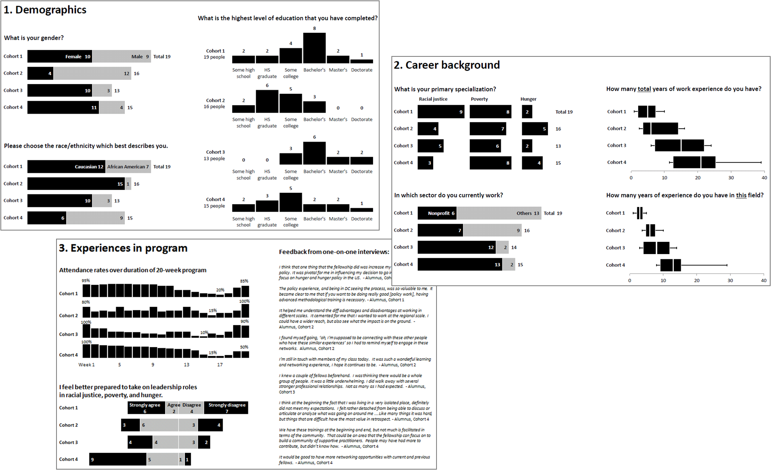
The Learning Journey
Data Placemats (Pankaj, 2014)
Pankaj & Emery, in press.

Slide 16
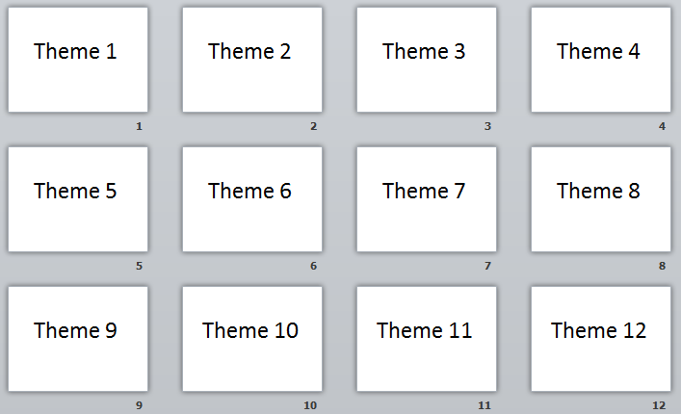

Slide 17
Questions for Stakeholders (Pankaj, 2014)
What surprises you about the data?
What factors may explain the findings?
Any new questions or themes?

Slide 18
References
Merriam, S. B. (2009). Qualitative research: A guide to design and implementation. San Francisco: Jossey-Bass.
Pankaj, V. (2014). Data Placemats. Presented at the American Evaluation Association Annual Conference, Denver, Colorado.
Pankaj, V., & Emery, A. K. (2016). Data placemats: A facilitative technique designed to enhance stakeholder understanding of data. In R. S. Fierro, A. Schwartz, & D. H. Smart (Eds.), Evaluation and Facilitation. New Directions for Evaluation, 149, 81–93, DOI: 10.1002/ev
Preskill, H., and Catsambas, T. T. (2006). Reframing evaluation through appreciative inquiry. Thousand Oaks: Sage.
Smith, N.L. (2010). Characterizing the Evaluand in Evaluating Theory. American Journal of Evaluation, 31, (3), 383-389.

Slide 19
References
Straits, K.J.E., Bird, D.M., Tsinajinnie, E., Espinoza, J., Goodkind, J., Spencer, O.,Tafoya, N., Willging, C. & the Guiding Principles Workgroup (2012). Guiding Principles for Engaging in Research with Native American Communities, Version 1. UNM Center for Rural and Community Behavioral Health & Albuquerque Area Southwest Tribal Epidemiology Center.
Whitney, D., and Trosten-Bloom, A. (2003). The Power of Appreciative Inquiry: A Practical Guide to Positive Change. San Francisco, CA: Berrett-Koehler Publishers, Inc.

Slide 20
Appreciative Inquiry Activity (Preskill & Catsambas (2006)
As an evaluator, determine by conducting interviews the effectiveness of a training program’s
1. Design
2. Relevance to participant’s jobs
3. Participant’s ability to transfer learning to their jobs
Develop both Appreciative Inquiry and non Appreciative Inquiry questions

Slide 21
Training Program Design
Non- Appreciative Inquiry Questions | Appreciative Questions
How well did the workshop balance small group activities and large group discussions? Were the case studies useful? Why or why not? | Think back on your experience in the workshop and tell me about a moment when you felt that an activity or lecture was working particularly well—so that it helped you learn and understand the content in a way that was exciting or inspiring. What was it that made it so effective? What value did you add to the workshop?

Slide 22
Relevance of Content
Non- Appreciative Inquiry Questions | Appreciative Questions
How relevant was the workshop content to your work? Which topics were relevant? | Reflecting on your experience in the workshop, remember a topic that you thought was particularly relevant to your work. What topic was it? Why was it relevant to what you do? What additional topics should the workshop include?

Slide 23
Transfer of Learning
Non- Appreciative Inquiry Questions | Appreciative Questions
Was it worth your time going to the workshop? What are some examples of how you might apply some of the things you learned? Who else might benefit from this workshop? | It has been several weeks since you participated in the workshop. What parts or aspects of the workshop are you finding to be most useful in your work? What have you used that has been particularly effective, successful, or exciting? What do you wish the workshop had included more of to make it even more useful?

